Slide 1



Digital Electronics

Slide 2


CHAPTER-3
COMBINATIONAL CIRCUITS

Slide 3
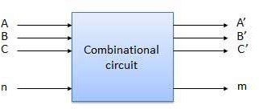
4.1: Introduction to Combinational circuits:
Combinational circuit is a circuit in which we combine the different gates in the circuit, for example encoder, decoder, multiplexer and demultiplexer. Some of the characteristics of combinational circuits are following:
The output of combinational circuit at any instant of time depends only on the levels present at input terminals.
This circuit do not use any memory. The previous state of input does not have any effect on the present state of the circuit.
It can have an n number of inputs and m number of outputs.
Image source : Google

Slide 4
4.2: Design Procedure
The procedure involves the following steps:
The problem is stated.
The number of available input variables and required output variables is determined.
The input and output variables are assigned letter symbols.
The truth table that defines the required relationships between inputs and outputs is derived.
The simplified Boolean function for each output is obtained.
The logic diagram is drawn.

Slide 5
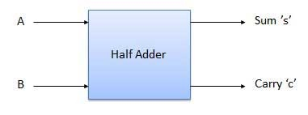
4.3: Adders
4.3.1: Half Adder:
The half adder circuit is designed to add two single bit binary number A and B. It is the basic building block for addition of two single bit numbers. This circuit has two outputs carry and sum.
S = A’B + AB’
C=AB
Inputs |  | Outputs
A | B | Sum | Carry
0 | 0 | 0 | 0
0 | 1 | 1 | 0
1 | 0 | 1 | 0
1 | 1 | 0 | 1
Image source : Google

Slide 6
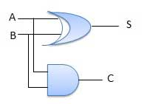
4.3: Adders (Continue..)
4.3.1: Half Adder (Continue..):
S = A’B + AB’
C=AB
Based on the above equations, the circuit can be designed as shown here.
Image source : Google

Slide 7
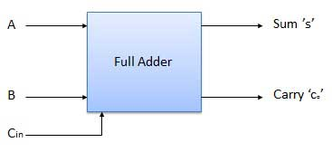
4.3: Adders (Continue..)
4.3.2: Full Adder :
Full adder overcomes the drawback of Half Adder circuit.
It can add two one-bit numbers A and B, and carry C.
The full adder is a three input and two output (Sum and Carry out) combinational circuit.
Image source : Google

Slide 8
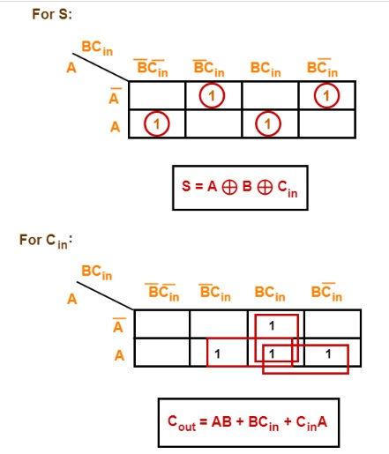
4.3: Adders (Continue..)
4.3.2: Full Adder (Continue):
Inputs |  |  | Outputs
A | B | Cin | S | Cout
0 | 0 | 0 | 0 | 0
0 | 0 | 1 | 1 | 0
0 | 1 | 0 | 1 | 0
0 | 1 | 1 | 0 | 1
1 | 0 | 0 | 1 | 0
1 | 0 | 1 | 0 | 1
1 | 1 | 0 | 0 | 1
1 | 1 | 1 | 1 | 1
Image source : Google

Slide 9
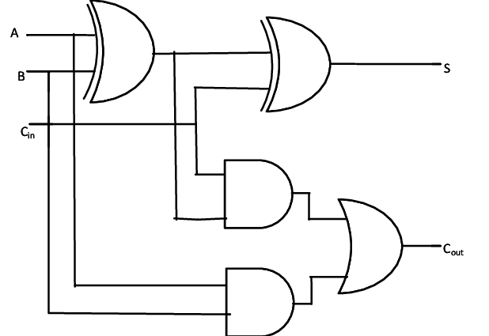
4.3: Adders (Continue..)
4.3.2: Full Adder (Continue):
From the derived equations, circuit of full adder can be designed as shown in figure.
Image source : Google

Slide 10
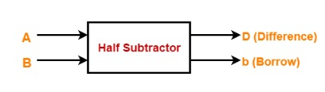
4.4: Subtractors (Continue..)
4.4.1: Half Subtractor:
A half-subtractor is a combinational circuit that subtracts two bits and produces their difference.
It also has an output to specify if a 1 has been borrowed.
Inputs |  | Outputs
A | B | Sum | Carry
0 | 0 | 0 | 0
0 | 1 | 1 | 1
1 | 0 | 1 | 0
1 | 1 | 0 | 0
Image source : Google

Slide 11
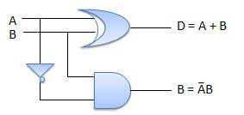
4.4: Subtractors (Continue..)
4.4.1: Half Subtractor (Continue..):
The simplified expressions for Sum and carry are as follows.
D = A’B + AB’
B=A’B
From the derived equations, the circuit of half subtractor can be designed as shown in figure.
Image source : Google

Slide 12
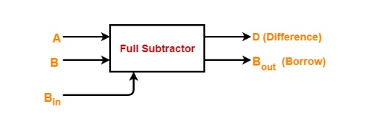
4.4: Subtractors (Continue..)
4.4.2: Full Subtractor:
Full subtractor overcomes the disadvantage of half-subtractor.
A full-subtractor performs a subtraction between two bits, taking into account that a 1 may have been borrowed by a lower significant stage.
It is a combinational circuit with three inputs A,B,C and two output D and B. A is the 'minuend', B is 'subtrahend', B is the 'borrow' produced by the previous stage, D is the difference output and C' is the borrow output.
Image source : Google

Slide 13
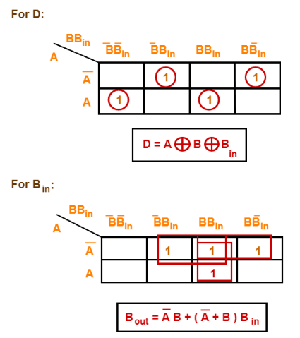
4.4: Subtractors (Continue..)
4.4.2: Full Subtractor (Continue..):
Inputs |  |  | Outputs
A | B | Bin | D | Bout
0 | 0 | 0 | 0 | 0
0 | 0 | 1 | 1 | 1
0 | 1 | 0 | 1 | 1
0 | 1 | 1 | 1 | 0
1 | 0 | 0 | 0 | 1
1 | 0 | 1 | 0 | 0
1 | 1 | 0 | 0 | 0
1 | 1 | 1 | 1 | 1
Image source : Google

Slide 14
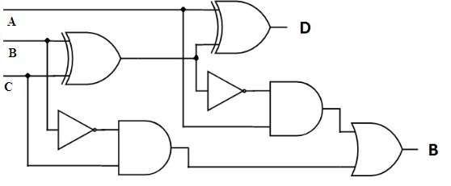
4.4: Subtractors (Continue..)
4.4.2: Full Subtractor (Continue..):
From the expressions derived in previous slide, the circuit of full subtractor can be designed as shown here.
Image source : Google

Slide 15
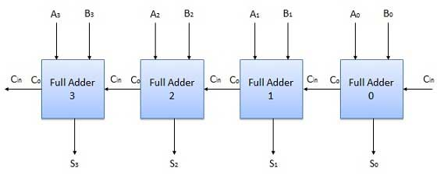
4.5: N-Bit Parallel Adder
To add two n-bit binary numbers we need to use the n-bit parallel adder. It uses a number of full adders in cascade. The carry output of the previous full adder is connected to carry input of the next full adder.
4-bit parallel adder is shown here.
Image source : Google

Slide 16
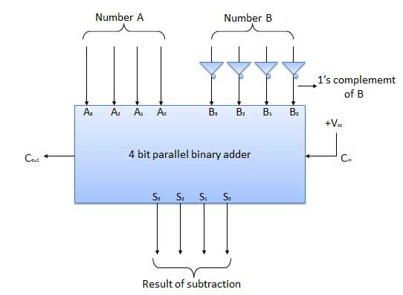
4.6: N-Bit Parallel Subtractor
To subtract one n-bit binary numbers from the other n-bit binary number, we need to use the n-bit parallel subtractor. It uses a number of full adders in cascade. But B is complemented then added to A.
So, A + Complement of B = A-B
4-bit parallel subtractor is shown here.
Image source : Google

Slide 17
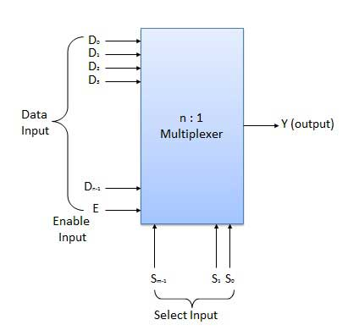
4.7: Multiplexers
A digital multiplexer selects binary information from one of many input lines and directs it to a single output line.
The selection of a particular input line is controlled selection lines.
2" input lines 🡺 n selection lines 🡺 1 output line
Image source : Google

Slide 18
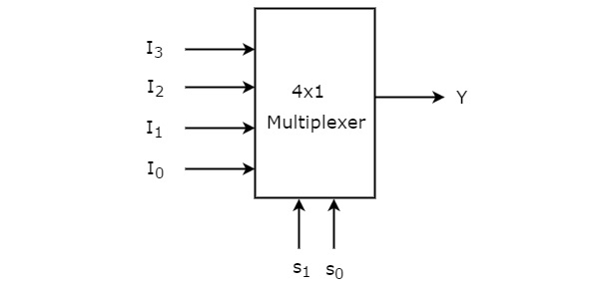
4.7: Multiplexers (Continue..)
Selection lines |  | Output
S₁ | S₀ | Y
0 | 0 | I₀
0 | 1 | I₁
1 | 0 | I₂
1 | 1 | I₃
4 : 1 Multiplexer
Truth table and block diagram of 4:1 multiplexer are shown here.
From the truth table, the Boolean expression is derived as follows.
Y=S1′S0′I0+S1′S0I1+S1S0′I2+S1S0I3
Image source : Google

Slide 19
4.8: De-Multiplexers
A de-multiplexer performs the reverse operation of a multiplexer i.e. it receives one input and distributes it over several outputs.
It has only one input, n outputs, m select input.
De-multiplexer come in multiple variations:
  1 : 2 demultiplexer
  1 : 4 demultiplexer
  1 : 16 demultiplexer
  1 : 32 demultiplexer
Image source : Google

Slide 20
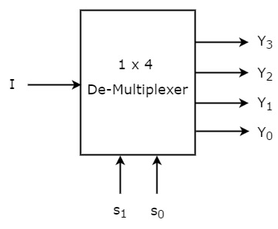
4.8: De-Multiplexers
1:4 De-multiplexer
1x4 De-Multiplexer has one input I, two selection lines, s1 & s0 and four outputs Y3, Y2, Y1 &Y0.
The block diagram or symbol of multiplexer is as shown here.
Image source : Google

Slide 21
4.8: De-Multiplexers (Continue..)
1:4 De-multiplexer (Continue..)
From the above Truth table, we can directly write the Boolean functions for each output as
Y3=s1s0I
Y2=s1s0′I
Y1=s1′s0I
Y0=s1′s0′I
Selection Inputs |  | Outputs
S₁ | S₀ | Y₃ | Y₂ | Y₁ | Y₀
0 | 0 | 0 | 0 | 0 | I
0 | 1 | 0 | 0 | I | 0
1 | 0 | 0 | I | 0 | 0
1 | 1 | I | 0 | 0 | 0
Image source : Google

Slide 22
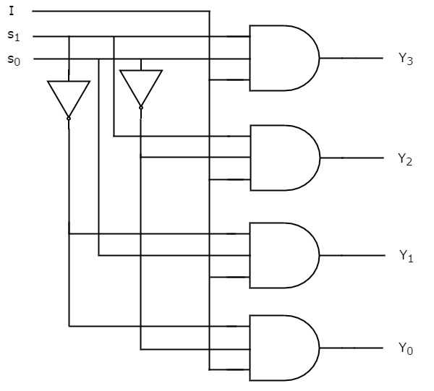
4.8: De-Multiplexers (Continue..)
1:4 De-multiplexer (Continue..)
  Y3=s1s0I
  Y2=s1s0′I
  Y1=s1′s0I
  Y0=s1′s0′I
From the above Boolean functions, we can design the circuit as shown here.
Image source : Google

Slide 23
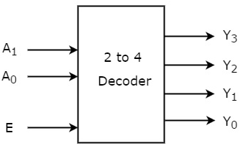
4.9: Decoder
A decoder is a combinational circuit that has n input and to a maximum m = 2n outputs. Decoder is identical to a de-multiplexer without any data input.
2 to 4 decoder
The block diagram of 2 to 4 decoder is shown here.
Image source : Google

Slide 24
4.9: Decoder (Continue..)
2 to 4 decoder (Continue..)
The truth table of 2 to 4 decoder is shown here.
From the truth table, the derived Boolean functions are:
  Y3=E.A1.A0
  Y2=E.A1.A0′
  Y1=E.A1′.A0
  Y0=E.A1′.A0′
Enable | Inputs |  | Outputs
E | A₁ | A₀ | Y₃ | Y₂ | Y₁ | Y₀
0 | x | X | 0 | 0 | 0 | 0
1 | 0 | 0 | 0 | 0 | 0 | 1
1 | 0 | 1 | 0 | 0 | 1 | 0
1 | 1 | 0 | 0 | 1 | 0 | 0
1 | 1 | 1 | 1 | 0 | 0 | 0
Image source : Google

Slide 25
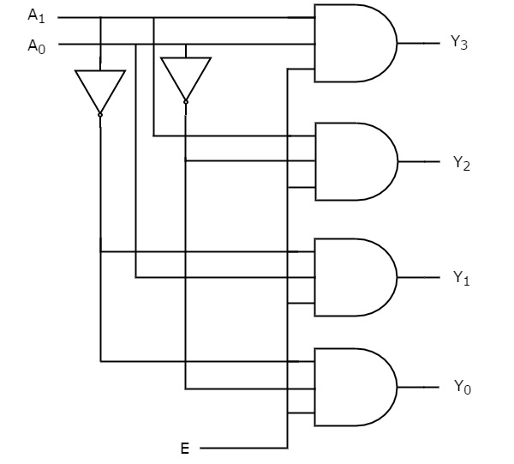
4.9: Decoder (Continue..)
2 to 4 decoder (Continue..)
From the derived Boolean functions, the circuit of 2 to 4 decoder can be designed as shown here.
Using similar method, 3 to 8 decoder can also be designed.
Image source : Google

Slide 26
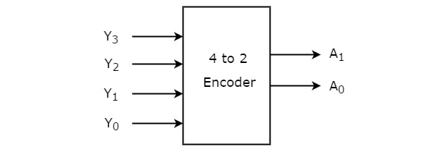
4.10: Encoder
An Encoder is a combinational circuit that performs the reverse operation of Decoder.
It has maximum of 2n input lines and ‘n’ output lines. It will produce a binary code equivalent to the input, which is active High.
4 to 2 Encoder:
The 4 to 2 Encoder has four inputs Y3, Y2, Y1 & Y0 and two outputs A1 & A0. The block diagram of 4 to 2 Encoder is shown here.
Image source : Google

Slide 27
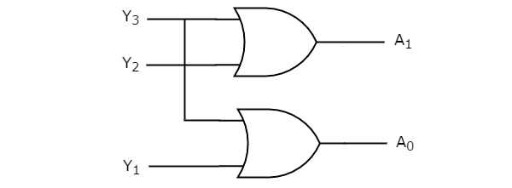
4.10: Encoder (Continue..)
The truth table of encoder is shown here.
Inputs |  |  |  | Outputs
Y₃ | Y₂ | Y₁ | Y₀ | A₁ | A₀
0 | 0 | 0 | 1 | 0 | 0
0 | 0 | 1 | 0 | 0 | 1
0 | 1 | 0 | 0 | 1 | 0
1 | 0 | 0 | 0 | 1 | 1
The Boolean function for each output are as follows:
A1=Y3+Y2
A0=Y3+Y1
Image source : Google

Slide 28
4.11: Code-Converters
The combinational circuits, which convert one code to other code are called as code converters.
These circuits mainly consist of Logic gates.
For example,
Binary code to Gray code converter
It is the combinational circuit which is designed to converts a 4-bit binary code B₃B₂B₁B₀ into its equivalent Gray code G₃G₂G₁G₀.
Image source : Google

Slide 29
4.11: Code-Converters (Continue..)
Binary code B₃B₂B₁B₀ | Gray code G₃G₂G₁G₀
0000 | 0000
0001 | 0001
0010 | 0011
0011 | 0010
0100 | 0110
0101 | 0111
0110 | 0101
0111 | 0100
1000 | 1100
1001 | 1101
1010 | 1111
1011 | 1110
1100 | 1010
1101 | 1011
1110 | 1001
1111 | 1000
From Truth table, we can design Boolean expression using K-maps.
Image source : Google

Slide 30
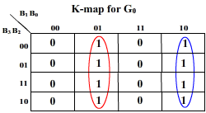
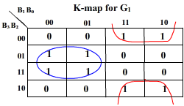
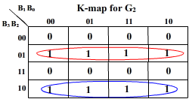
4.11: Code-Converters (Continue..)
From the truth table, k-map can be generated.
From truth table and k-map, the simplified expression output digits are
G₀=B₁’B₀+ B₁B₀’ 🡺G₀=B₁ ⊕B₀
G1=B1’B2+ B1B2’
G1=B1 ⊕B2
G2=B3’B2+ B3B2’
G2=B2 ⊕B3
And G3=B3
Image source : Google

Slide 31
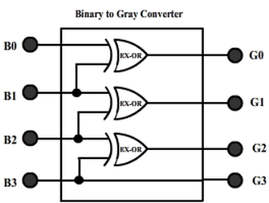
4.11: Code-Converters (Continue..)
From the above derived Boolean expressions, we can design the combinational circuit using logic gates as follows.
Image source : Google

Slide 32


www.paruluniversity.ac.in

